Slide 1
Origin of patent
Term patent has its origin in the term “letters Patent”These were instruments under the Great Seal of the King of England addressed by the Crown to all the subjects at large in which the Crown conferred certain rights and privileges on one or more individuals in the kingdom

Slide 2
Indian Patents and Designs Act was enacted in 1911
Patents bill 1953 was submitted by a Patents enquiry commitee based on the United Kingdom Patents act 1949. Bill however lapsed
Patents bill has been based by both houses o parliament in 1970
With amendments in 1974, 1999,2002,2005.

Slide 3
Meaning of the term Patent
It grants some privilege ,property or authority made by govt or sovereign of the country to one or more individuals.
The instrument by which such grant is made is know as patent.
Term patent got a statutory meaning in India when the patent act 1970 was enacted.
Patent under the act is granted by the controller to the inventor for a period of 20 years. It is the exclusive right to make use, exercise and vend his invention
The person to whom a patent is granted is called patentee
Patent agent means a person for the time being registered under the patents act as a patent agent

Slide 4
Patent a form of property
An invention is the creation of intellect applied to capital and labour to produce something new and useful. Such creation becomes the exclusive property of the inventor on grant of patent
The patentee’s exclusive right over invention is an intellectual property rights
Ownwer of the property can deal with it like any other movable property i.e.the patentee can sell the whole or part of his property(patent . He can grant licience to others to use the patented property, or assign the property to any other(s). Such a sale, licience or assignment of patent property is for valuable consideration

Slide 5
Objective behind patent law
Patent law recognis the exclusive right of a patentee to gain commercial advantage out of his invention
It encourage the inventors to invest their creative faculties, knowing their inventions would be protected by law and no one else would be able to copy their inventions for a certain period of time during which the inventor has exclusive rights
Price for grant of monopoly is the disclosure of the invention at the patent office.
After expiry of the fixed period of monopoly it passed into the public domain.
Fundamental principle of patent law to grant a patent only for an invention which must be new and useful. Thrust is on novelty and utility. Must be more than workshop improvement.

Slide 6
Principles underlying the patent law in India
It must be novel
It must involve on inventive step
It must be caplble of industrial application
Must not fall within any categories of subject matter specific excluded or made subject to expection

Slide 7
Exceptions

Slide 8
Exceptions

Slide 9
Principles underlying the patent law in India
Invention must be new useful and non-obvious
Newness
Usefulness
Exceptions
Non-obviousness
Invention must be disclosed fully
Distinction between discovery and invention
Use and acquisition of patented invention by the central government

Slide 10
Procedure for obtaining Patent
Submission of applications
Publication and examination of applications
Opposition to grant of patent to the applicant
Grant and sealing of patent.

Slide 11
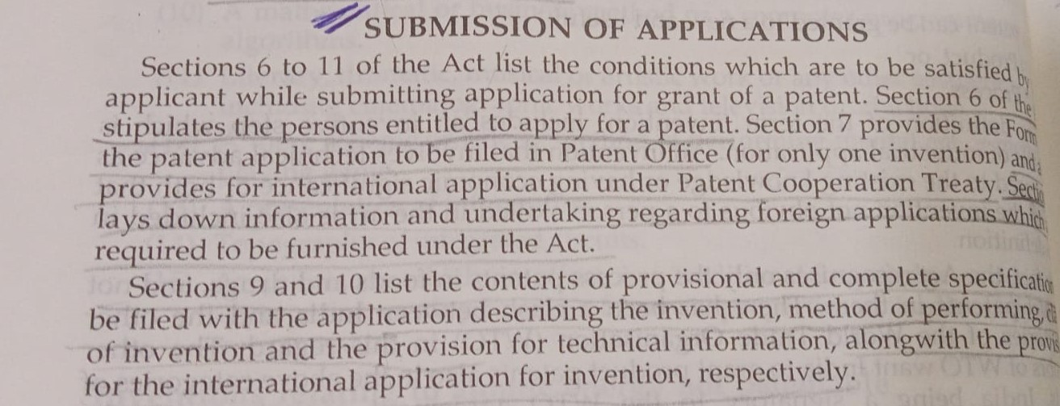

Slide 12
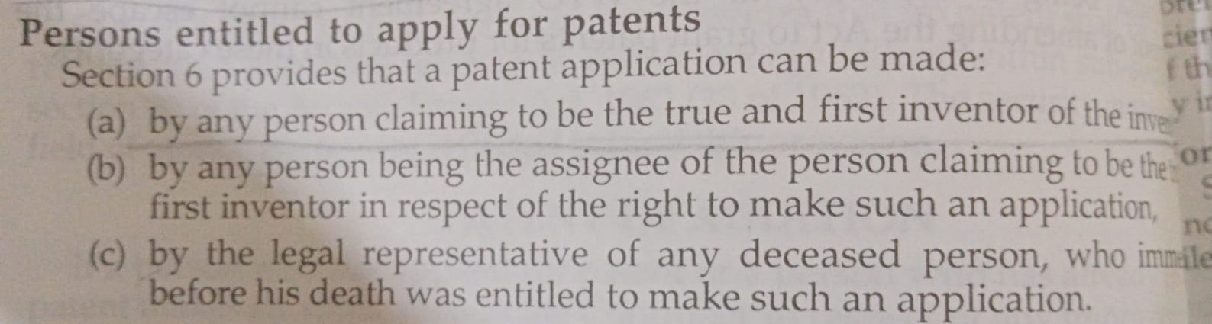

Slide 13
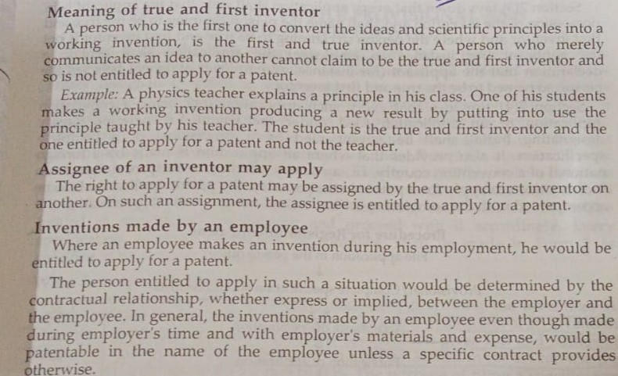

Slide 14
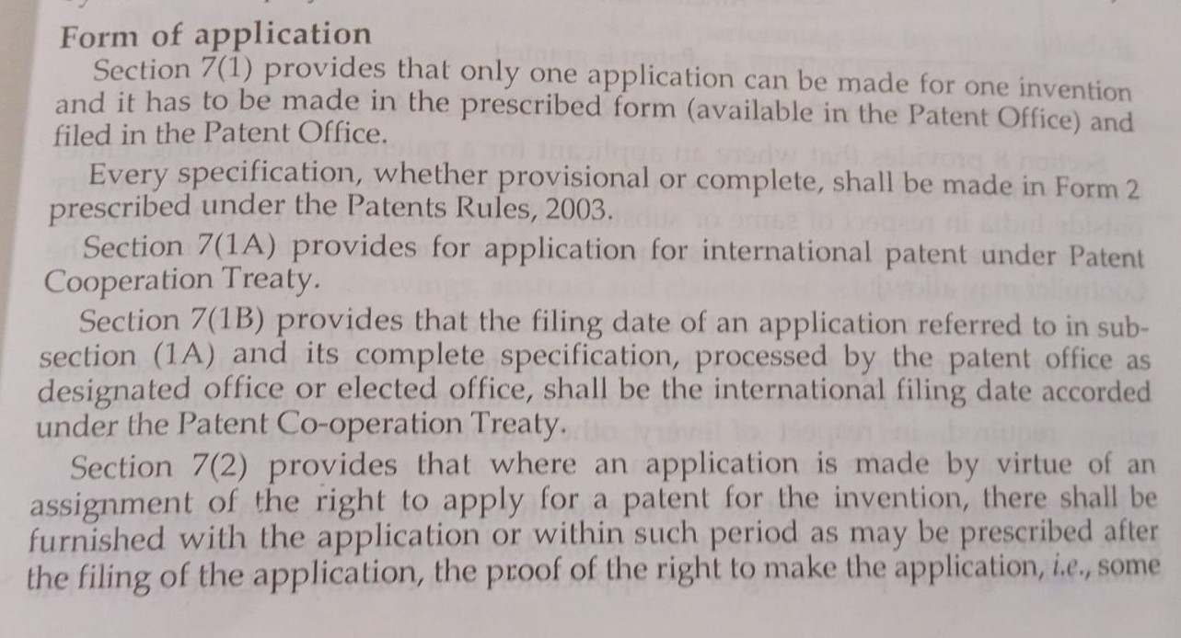

Slide 15
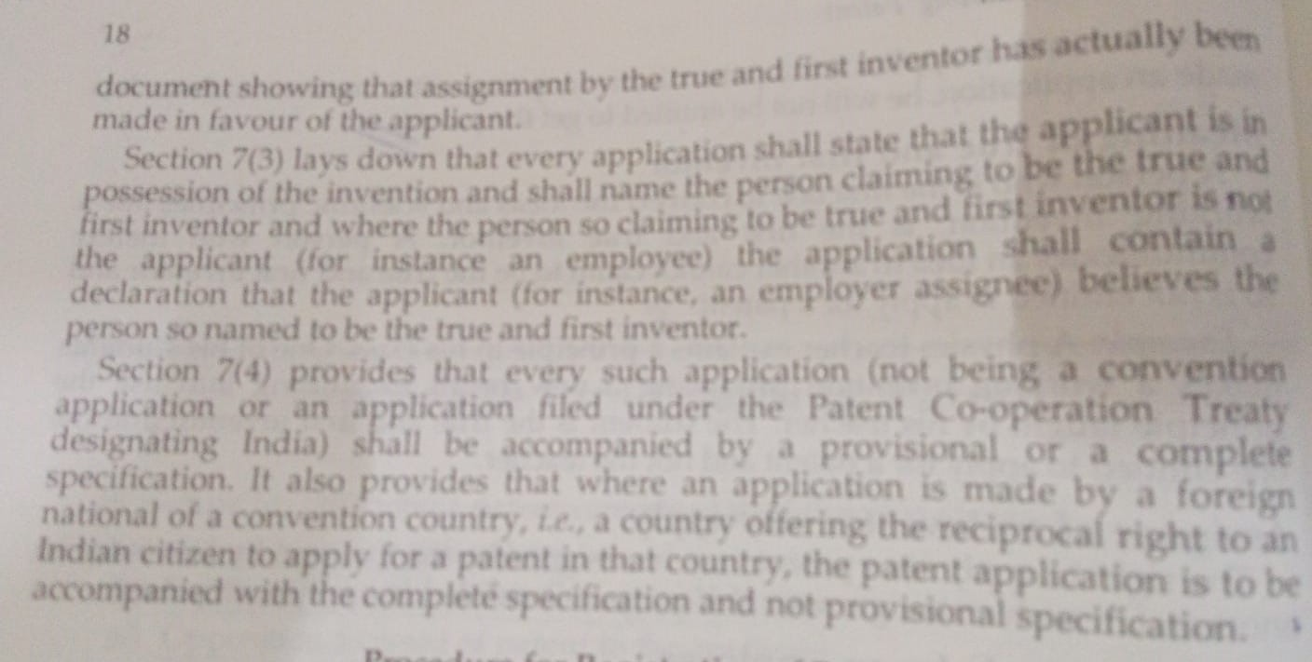

Slide 16
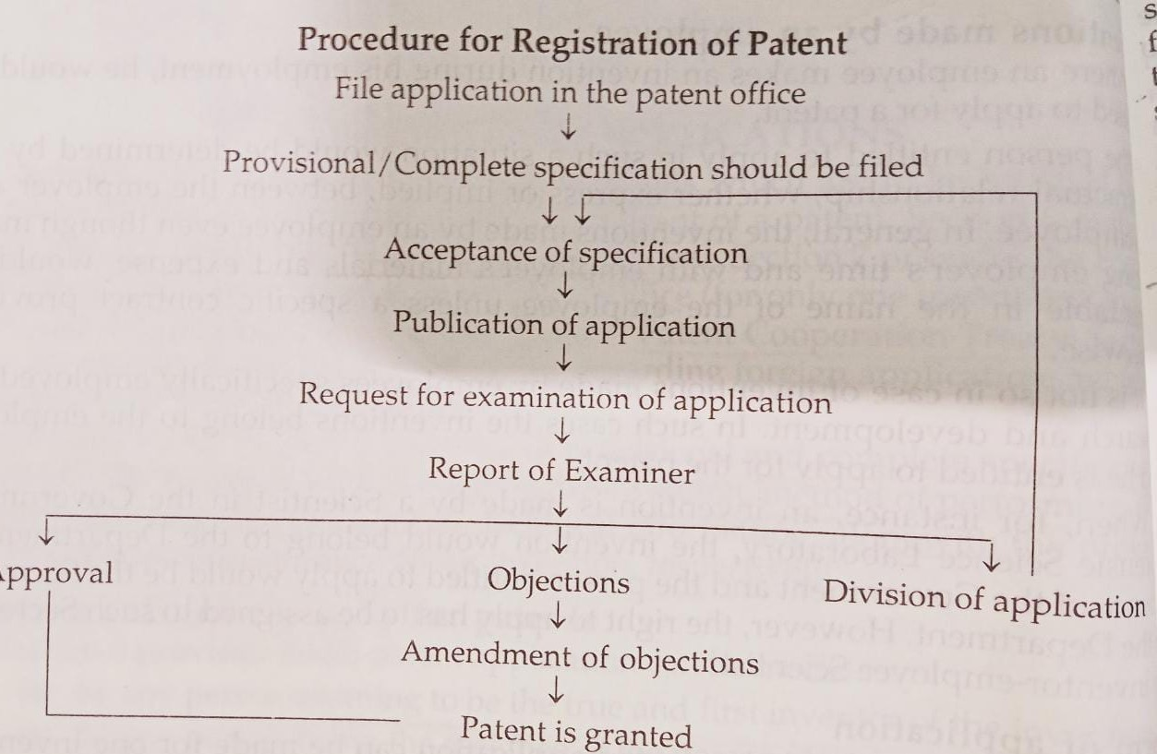

Slide 17
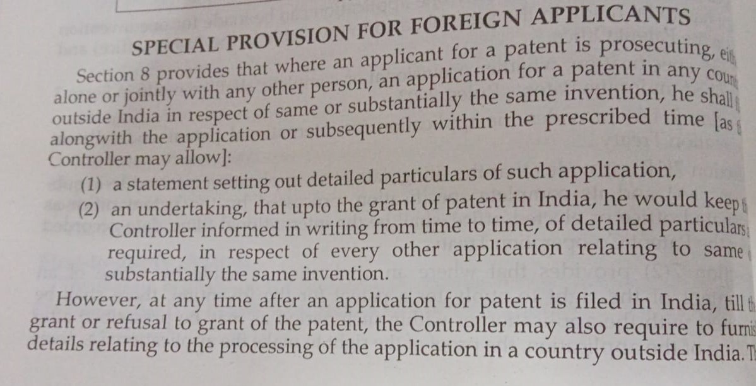

Slide 18
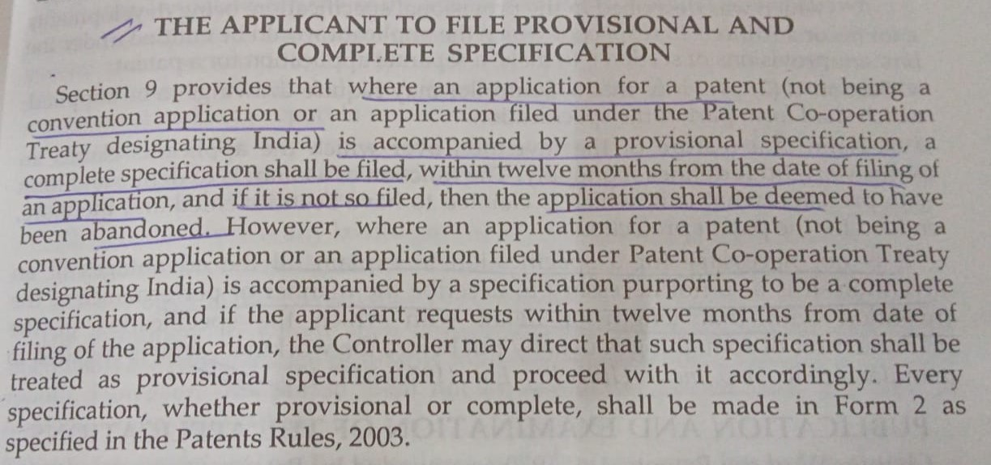

Slide 19
